Slide 1
Department of Local Government
IMPLEMENTATION OF THE TRADITIONAL AND KHOI-SAN LEADERSHIP ACT, 2019 (ACT 3 OF 2019)
Cederberg Municipality
28 August 2025

Slide 2
Outline
Purpose
Introduction
Overview of the implementation process
Status and progress update on the implementation: National Government
Status and progress update on the implementation: Provincial Government
Cost Implications- Implementation of the Act
Why the need to develop policies and/or provincial legislation

Slide 3
Purpose
  The purpose of this presentation is to provide a status and progress update on the implementation of the Traditional and Khoi-San Leadership Act, 2019 (Act 3 of 2019) by the National Department of Traditional Affairs, the Commission on Khoi-San Matters and the Provincial Department of Local Government.

Slide 4
Introduction
Section 211(1) of the Constitution of the Republic of South Africa, 1996 (“the Constitution”), recognises the institution, status and role of traditional leadership according to customary law, subject to the Constitution. Section 211(2) states that “[a] traditional authority that observes a system of customary law may function subject to any applicable legislation and customs, which includes amendments to, or repeal of, that legislation or those customs”.
Section 212 provides that “national legislation may provide for a role for traditional leadership as an institution at local level on matters affecting local communities”.
The Traditional Leadership and Governance Framework Act, 2003 (Act 41 of 2003) (“the TLGF Act”), commenced on 24 September 2004, and dealt with disputes and claims relating to traditional leadership. This Act did not deal with Khoi-San leadership.

Slide 5
Introduction
  The Traditional and Khoi-San Leadership Act, 2019 (Act 3 of 2019) commenced on 1 April 2021.
  In summary, the TKL Act provides for:
the recognition of traditional and Khoi-San communities and leadership positions;
the functions and roles of traditional and Khoi-San leaders;
the recognition, establishment, functions, roles and administration of kingship and queenship councils, principal traditional councils, traditional councils, Khoi-San councils and traditional sub-councils, as well as the support to such councils;
the establishment, composition and functioning of the National House of Traditional and Khoi-San Leaders, the establishment of provincial houses of traditional and Khoi-San leaders, and the establishment and composition of local houses of traditional and Khoi-San leaders;
the establishment and operation of the Commission;
a code of conduct for members of the National house, provincial houses, local houses and all traditional and Khoi-San councils.

Slide 6
Contextual Overview
The Premier has assigned his powers and functions as provided for in the TKLA to the Provincial Minister responsible for local government.
No traditional leaders, traditional communities, traditional councils, Khoi-San leaders, Khoi-San communities and Khoi-San councils are currently recognised in the Western Cape. (or in any province)
No decision has been made regarding the establishment of a Western Cape Provincial House of Traditional and Khoi-San Leaders, the decision will be informed by the number of Khoi-San leaders that are recognised- Practices seem to suggest that the Province will have to consider establishing local houses and that most provinces are establishing their local houses at a district level.
To implement the TKLA , provinces are required to develop legislative or any other appropriate means. For the Western Cape, the traditional and Khoi-San leadership function is new and that means new policies and provincial legislation should be in place before any recognition of traditional or Khoi-San community and leadership positions is done.
In preparation for the implementation of the provisions of the TKLA , the Department in collaboration with the Department of Sport, Recreation, Arts and Culture embarked on a benchmarking exercise with the Eastern Cape, Northwest, KwaZulu Natal and the Northern Cape Provinces.

Slide 7
Overview of the implementation process
Implementation of the Traditional and Khoi-San Leadership Act, 2019 (Act 3 of 2019
Investigation and assessment of the applications
Opening of the Application process for recognition
Recommendation to the Minister of Traditional Affairs
Establishment of the Commission of Khoisan Matters
Refer recommendation to the Premier of the Province for comments
Recognised Khoi-San Leadership, Branch Heads, Communities and Branches,
Provincial Government
Provide administrative and financial support to recognised Khoi-San Communities, Branches, Leadership and Branch Heads
Local Government
Involve recognised Khoi-San leadership and Branch heads in municipal councils

Slide 8
Overview of the implementation process
National Government
Establishment of the Commission on Khoisan Matters
Receive and investigate applications
Provincial Government
Local Government
Once recognised
Involving recognised Khoi-San leaders and Branch Heads in municipal processes
Make recommendation
Investigate development of policies and/or legislation
Prior to recognition
Develop institutional capacity to implement the Act
Provide support to the recognised Khoi-San leaders and institutions
Once recognised
Facilitates recognition

Slide 9
Status and progress update on the implementation: National Government
In terms of the Act, the first phase of the process relating to the recognition of Khoi-San leaders and communities is conducted by the Commission. The Commission was established, and its members were appointed with effect from 1 September 2021 (General Notice 500 of 2021 in Government Gazette 45044 of 25 August 2021
In terms of section 52(1)(a) of the TKL Act, the appointment of the members of the Commission must be for a period not exceeding five years (31 August 2026), or any such further period as the Minister of Traditional Affairs (“the National Minister”) may determine by notice in the Gazette.
Four persons were appointed as members of the Commission:
Prof Nico Adam Botha (Chairperson),
Mr Douglas Langley Bennett (Deputy Chairperson),
Ms Nokubonga Nokwanda Mazibuko-Ngidi, and
Dr (Prof retired) Edna Lorraine van Harte.

Slide 10
The Commission will…..
Investigate and make recommendations in respect of those applications that have been lodged with the Commission within a period of two years.
Complete the investigations and make recommendations within the period of appointment of the members of the Commission (five years or such further period as the National Minister may determine).
Refer its recommendation to the Premier of the province concerned prior to submitting its recommendation to the National Minister for Traditional Affairs.

Slide 11
Status and progress update on the implementation: National Government
The National Minister determined 30 March 2022 as the date from which the Khoi-San communities and leaders may lodge applications for recognition with the Commission (Notice 1639 of 2021 in Government Gazette 45690 of 24 December 2021)
Applications were to be submitted to the Commission by 29 March 2024. However, the National Minister for Cooperative Governance and Traditional Affairs has extended the period within which purported Khoi-San Communities, Khoi-San branches, senior Khoi-San leaders and Khoi-San branch heads may lodge applications for recognition to the Commission to 29 May 2025.
Subsequently the Minister for Cooperative Governance and Traditional Affairs extended this period to 29 May 2025 (Government Gazette No. 4327 of 02 February 2024). Thereafter, all applications for recognition must be submitted to the Premier concerned, however, this is subject to the outcomes of the court judgement as delivered on 30 May 2023.
In February 2022, the Commission published the application forms for recognition of Khoi-San leaders and communities(Provincial Notice 802 of 2022 in Government Gazette 45865 of 4 February 2022).
The Commission launched an awareness campaign on the application process for the recognition of Khoi-San communities and leaders in Cape Town on 25 March 2022.
Awareness campaigns have been conducted across the nine provinces, an awareness campaign for the Western Cape Province took place on 28 June 2022 (only one has been conducted to date).

Slide 12
Time-lines
Below are the activities by the National Department and the Commission
*Unless extended by the National Minister
Term of office of the Commission
Five years
Submission of applications for recognition with the Commission
Three years
Launch of the National Awareness Campaign
25 March 2022
Western Cape Awareness Campaign
28 June 2022
From 30 March 2022 to 29 May 2025*
From 1 September 2021 to 31 August 2026 *

Slide 13
Status and progress update on the implementation: Provincial Government
The Premier assigned the powers and functions relating to traditional and Khoi-San affairs to the Provincial Minster responsible for local government ("the Provincial Minister”), with effect from 30 August 2021 (Provincial Notice 88/2021 in Provincial Gazette 8486 of 3 September 2021
The Regulatory Impact Assessment (RIA) process (a prerequisite when developing provincial policies and legislation) has commenced, and the Significance Test was presented to the Central RIA Steering Committee.
The Department is conducting research for the possible development of a provincial policy and/or provincial legislation.
Anticipate to finalise the policy and/or legislative process by December 2025.
In preparation for the implementation of the provisions of the Act, the Department in collaboration with the Department of Cultural Affairs and Sport (DCAS) embarked on a benchmarking exercise with the Eastern Cape, North West, KwaZulu-Natal and the Northern Cape Provincial Departments.
Based on the engagements, the Provincial Department has costed the human and financial resource capacity requirements for the short, medium and long term based on a basic structure, and prioritised positions to commence with the initial work.

Slide 14
Time-lines
Below are the activities by the Department
Assignment of powers and functions by the Premier to the Provincial Minister
Published on 3 September 2021, with effect from 20 August 2021
Delegation of powers and functions
Signed by the Premier on 16 November 2021, and signed by the Provincial Minister on 17 November 2021
Finalisation of possible Provincial Policy
31 December 2025
Finalisation of possible provincial Legislation
31 December 2025

Slide 15
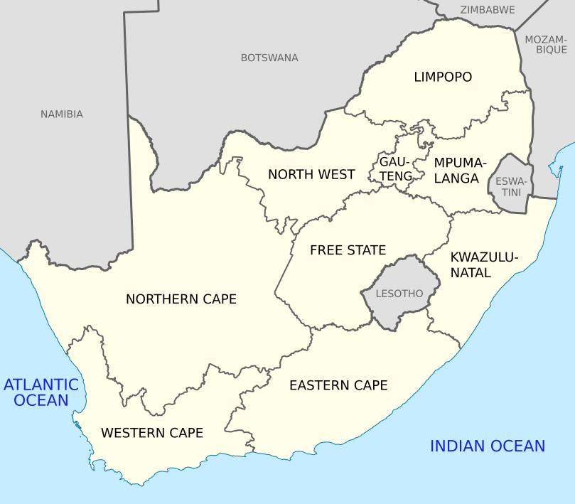
Applications received – National
0
18
South Africa
237
0
0
42
10
19
31
117

Slide 16
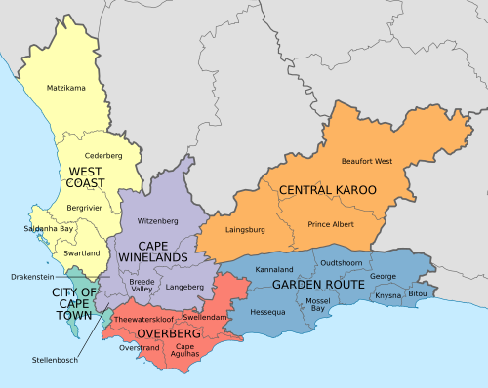
Applications received- Western Cape
Total 117
6
0
31
17
56
7

Slide 17
Applications received – Western Cape
Garden Route (17) | No | Cape Winelands (31) | No | City of Cape Town (56) | No
Ladismith | 3 | Robertson | 2 | Athlone | 1
Zoar | 1 | Wolseley | 2 | Manenburg | 1
Oudtshoorn | 2 | Rawsonville | 3 | Hanover Park | 1
Mosselbaai | 4 | Touwsrivier | 1 | Somerset West | 1
Knysna | 2 | Worcester | 6 | Tokai | 1
Pacaltsdorp | 1 | Montagu | 1 | Pinelands | 1
Plettenberg Bay | 2 | Wellington | 1 | Ravensmead | 1
Overberg (7) |  | Paarl | 5 | Mitchells Plain | 5
Villiersdorp | 3 | Stellenbosch | 9 | Cape Town | 18
Swellendam | 2 | Tulbagh | 1 | Parow Valley | 2
Elim | 1 |  |  | Eersterivier | 1
West Coast (6) |  |  |  | Gugulethu | 1
Bitterfontein | 1 |  |  | Strandfontein | 1
Langebaan | 1 |  |  | Mamre | 1
Saldanha | 1 |  |  | Elsies River | 1
Moorreesburg | 2

Slide 18
Applications received – Western Cape
Garden Route | No | City of Cape Town | No | City of Cape Town | No
Riversdale | 2 | Lansdowne | 1 | Delft | 1
 |  | Lotus River | 1 | Belhar | 1
 |  | Kraaifontein | 3 | Rondebosch East | 1
 |  | Macassar | 1 | Bellville | 1
 |  | Blackheath | 1
 |  | Kuils River | 1
 |  | Atlantis | 2
Overberg |  | Bonteheuwel | 1
Caledon | 1 | Zeekoevlei (Cape Flats) | 1
 |  | Lavender Hill | 1
West Coast |  | Hout Bay | 1
Piketberg | 1 | Green Point | 1
 |  | Total | 117

Slide 19
Current and Planned initiatives
The commission is currently conducting Phase 1 assessment- Applicant Member Investigation- which involves a selection of 10 members who have applied- allocate four hours to take them through the application and the information submitted vs what is required where necessary assist with research.
The engagement is conducted on a one-on-one basis and based on the applications received and time – this is to ensure integrity of the process.
Awareness session are planned for all Provinces the plan for the Western Cape is as follows (Provisional):
District/ Metro | Area
Central Karoo | Beaufort West
Overberg | Caledon
Cape Winelands | Worcester
West Coast North | Vredendal
West Coast South | Saldanha
Garden Route (Coast) | George
Garden Route (Inland) | Oudtshoorn
City of Cape Town | Cape Town

Slide 20
Why need to develop policies and /or provincial legislation
The Act makes provision for Provincial Houses of Traditional and Khoi-San leaders which may be established by provinces in terms of provincial legislation.
The Act makes provision for the establishment of a local house of traditional and Khoi-San leaders for the area of jurisdiction of a local municipality, district municipality or a metropolitan municipality where there is one or more traditional councils or Khoisan Councils by way of a Provincial Gazette by the Premier.
Section 18 of the act provides for the recognition of the Khoi-San Community by the Premier or the Minister. Once recognised the recognised community within a given period must establish a Khoi-San council.
The TKLA, in various provisions, empowers provinces to adopt legislative and other measures necessary to implement the TKLA.
The purpose of the proposed policies and or legislation is to provide for the regulatory mechanism for the Department to be able to implement the TKLA by supporting Khoi-San leadership positions, institutions and communities once recognised or established in terms of the TKLA.

Slide 21
Why need to develop policies and /or provincial legislation
Develop policies and or provincial legislation with respect to the following:
Mechanism to deal with disputes, section 57 read with section 59;
Regulations in respect of elections of members of the Khoi-San councils, Section 21; and regulations regarding local houses, Section 50
Establishment of the provincial house Section 15,
Support and strengthen the capacity of Khoi-San councils including the provisions of administrative and financial support, Section 23,
Regulation of partnerships and agreements, Section 24,
A provincial department may provide for a role of Khoi-San council and Khoi-San leaders in respect of any functional area of such department, Section 25,
Administration and financial support to the recognised-
Recognition of Khoi-San communities and branch section 5, withdrawal of such recognition section 6
Recognition of leadership positions section 7, recognition of Khoi-San leader or branch leader section 10, withdrawal of Khoi-San leader and Branch head section 11
Recognition of regent section 12
Recognition of acting Khoisan leaders section 13, recognition of deputy Khoi-San leaders section 14

Slide 22
Cost Implications –Implementation of the Act
Cost Drivers:
Human Resource Requirements (Departmental).
Providing administrative and financial support to the established houses.
Remuneration for the different categories of traditional leaders.
Tools of the Trade for Traditional Leaders, transport, incidental and other expenditures - Independent Commission for the Remuneration of Public Office Bearers.
The Department costed the human and financial resource capacity requirements for the short, medium and long term based on a basic structure and prioritised positions to commence with the initial work ( Research, Policy and/or Legislation Development). The overall structure will be influenced by the outcomes of the OD process.

Slide 23
Cost Implication –Implementation of the Act
The Independent Commission for the Remuneration of Public Office Bearer’s recommendation deal with the following tools of trade (extensively described in the Tools of Trade for Traditional Leaders)(The Department of Traditional Affairs is currently working with National Treasury to do costing of the tools of the Trade Handbook:
Official and private accommodation;
Offices, office supplies and stationery;
Information technology and communication (ITC) equipment;
Adequate and professional staff support;
Official and private travelling facilities;
Reimbursement allowances;
Security;
Study aids;
Other facilities.

Slide 24
Cost Implication –Implementation of the Act
Support to Khoi-San Houses and Khoi-San Councils
As stipulated in ss 50 (10) and 23 the support entails the following :
The Province must provide administrative and financial support to provincial and local houses, the support may include and not limited to, office accommodation and support staff.
Monitor and manage the finances of the councils
Assists traditional councils through grants to augment the salaries of traditional council employees. The latter may be the case in relation to Khoi-San Councils.
Given that the Khoi-San leaders will be working along with institutions which have long been established, capacity building also becomes a necessity, this may include code of conduct for members of the Provincial House.
In consultation with the Provincial Treasury open an account for each established council to perform transactions such as payment of moneys due to the councils, expenditure of the councils -must establish financial systems and controls
The purpose of the development of policies and or legislation is to provide for the regulatory mechanism for the Department to be able to implement the TKLA and support Khoi-San leadership positions, institutions and communities once recognised or established in terms of the TKLA.

Slide 25
Cost Implication –Implementation of the Act

Slide 26
Cost Implication –Implementation of the Act
The TKLA provides for different categories traditional Leaders, the categories of Khoi-San leaders which may be recognised in terms of section 7 (b) of the Act, are Senior Khoi-San Leaders, Branch Heads.
The remuneration of Public Office Bearers Act, No 20 of 1998 as amended provides for salaries, allowances and benefits of traditional leaders and members of the houses.
The annual remuneration for the different categories of traditional leaders are as follows (Source No 50956, Government Gazette, 22 July 2024 (Proclamation notice 171 of 2024).
The total cost for the remuneration of recognised leaders will only be confirmed once the number and categories of Khoi-San leaders are confirmed by the Commission on Khoi-San Matters.
The amounts listed above exclude provisions for tools of trade, transport, incidental and other expenditure.
Position | Grade | Pay Level | Salary p.a
King or Queen | TA | 1 | R1 388 764
Principal Traditional Leader | TB | 1 | R 1 277 668
Senior Traditional Leader | TC | 1 | R 303 467
Headman or Headwoman | TD | 1 | R 130 394

Slide 27
Cost Implication –Implementation of the Act
Salaries for members of the houses (Source No 47125, Government Gazette, 12 July 2022 (Proclamation notice 73 of 2022).
No | Grade | Salary p.a
1 | Full-time Chairperson: Provincial House of Traditional Leaders | R860 954
2 | Full-Time Deputy Chairperson Provincial House of Traditional Leaders | R 799 501
3 | Full-Time Member Provincial House of Traditional Leaders | R 398 562
Sitting Allowances for part-time positions*
1. | Chairperson: Provincial House of Traditional Leaders | 2 028
2 | Deputy Chairperson Provincial House of Traditional Leaders | 1 825
3 | Member Provincial House of Traditional Leaders | 1415
* In addition to sitting allowances, part –time members are entitled to their salaries as Traditional Leaders as well a subsistence costs ( reasonable and actual expense) and transport costs for their attendance of official meetings, workshops & conferences.

Slide 28
Constitutional Court Judgement
Mogale and Others v Speaker of the National Assembly and Others (Case Number: CCT 73/22)
  The applicants raised a few constitutional objections to the content of the Act, including that it entrenches and worsens the position under the Framework Act, however the Court mainly considered the challenge on what the applicants regarded as insufficient Parliamentary public participation processes.
On 30 May 2023, the Constitutional Court delivered its judgement on the matter and, amongst others, made the following orders:-
“It is declared that Parliament has failed to comply with its constitutional obligation to facilitate public involvement before passing the Traditional and Khoi-San Leadership Act 3 of 2019 (Act).
The Act was, as a consequence, adopted in a manner that is inconsistent with the Constitution and is therefore declared invalid.
The order declaring the Act invalid is suspended for a period of 24 months to enable Parliament to re-enact the statute in a manner that is consistent with the Constitution or to pass another statute in a manner that is consistent with the Constitution.”
The Act remains valid until 29 May 2027 and may therefore continue to be implemented.
Should Parliament not re-enact the Act or enact a new Act within the period of suspension, the current Act will automatically be invalid retrospectively and everything that was done in terms of the Act will be null and void.
In which case, the previous (repealed) laws (the Traditional Leadership and Governance Framework Act, 2003 and the National House of Traditional Leaders Act, 2009) will automatically be reinstated.
Should Parliament not be able to meet the deadline set by the Constitutional Court, Parliament may approach the Court for an extension of the original 24-month period. However, Parliament will have to indicate to the Court which processes it already commenced with (and finalised) to comply with the Court order.

Slide 29
Cabinet Statement – 20 September 2024 (in response to the judgement) ( for Noting)
Cabinet approved the submission of the Traditional Khoi-San Leadership Bill of 2024 to Parliament. The Bill is a response to the Constitutional Court ruling that declared the Traditional and Khoi-San Leadership Act, 2019 (Act 3 of 2019) invalid based on insufficient public participation by Parliament.
The Bill will give Parliament an opportunity to comply with the order of the Constitutional Court. The Traditional and Khoi-San Leadership Act of 2019 replaced the Traditional Leadership and Governance Framework Act, 2003 (Act 41 of 2003).

Slide 30





Update on the Traditional and Khoi-San leadership Bill 2024
29 May 2025
29 May 2027
The order of invalidity was suspended for 24 months, up to 29 May 2025, the TKLA would have lapsed on this date.
Parliament to finalise processing of the Bill, conduct the required public participation.
30 May 2023
The Constitutional court Judgement of 30 May 2023 ordered that Parliament failed to comply with its constitutional obligation to facilitate public participation on the Bill before passing the Act, as a result the Act was declared unconstitutional and invalid
May 2025
November 2024
The Minister of COGTA approached the Constitutional Court for an extension of the initial 24 months- the Constitutional Court granted the 24 months extension- up to 29 May 2027.
The Department of Traditional Affairs published the Draft Traditional and Khoi-San Leadership Bill in the Government Gazette for public Comment.

Slide 31
Update on the Traditional and Khoi-San leadership Bill 2024
28 February 2025
29 May 2025
Closing date for public comments was 28 February 2025 (Three months)- the Bill was revised.
The receiving of applications closed on 29 May 2025 linked to the court order- the department is currently waiting for legal opinion on this to guide provinces on the application process- the 2019 Act indicated that once the initial period determined by minister, applications to be received by the premier
End September 2025
June - August 2025
It is envisaged that the Bill will be submitted to Cabinet for approval for tabling in parliament
The Bill was submitted to the Office of the Chief State Law Advisor for pre-certification and Presidency for the Socio-Economic Impact Assessment certification
Once approved by Cabinet
The Bill will be tabled to Parliament after approval by the Cabinet

